Slide 1

Interview Questions

Slide 2

Subscribe Please

Slide 3
Infosys Interview Coding Question
Dynamic Programming
Frog Jump
Ninja's Training
House Robber
Unique Paths
Triangle
Subset Sum Equals to Target
0/1 Knapsack
Minimum Coins
Best Time to Buy and Sell Stock
Climbing Stairs
Download this document: https://saurabhjha.live/study_material

Slide 4
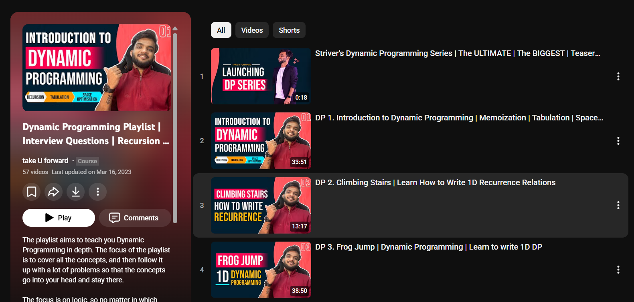
Infosys Interview Coding Question
Dynamic Programming
Download this document: https://saurabhjha.live/study_material

Slide 5
Infosys Interview Coding Question
Graphs
BFS
DFS
Island
Rotten Oranges
Detect Cycle
World Leader
Dijikstra Algorithum
Print Shortest Path
prim’s Algo
No Ways to reach Destination
Download this document: https://saurabhjha.live/study_material

Slide 6
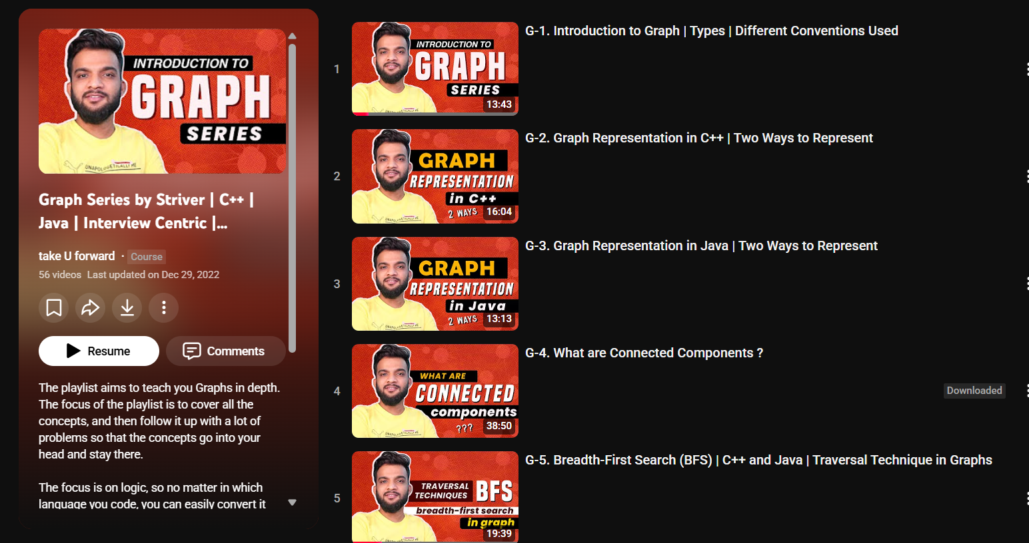
Infosys Interview Coding Question
Download this document: https://saurabhjha.live/study_material

Slide 7
Infosys Interview Coding Question
LInkedlist
Doubly LinkedList
Cycle Detection
Remove Nth Node From the Linkedlist
merge 2 sorted list
Binary Tree
preorder, inorder, postorder traversal
Maximum Depth
Botto, top , side View
Download this document: https://saurabhjha.live/study_material

Slide 8
Infosys Interview Coding Question
Arrays
Longest Subarray with K sum
2 Sum, 3 Sum
Kadane’s Algorithum
pascal Tringle
Find Missing and Repeting
Stack and Queue
Next Greter Element
Sliding Window Maximum
Astroid Collisons
Remove K Digit
perfect Bracket
Download this document: https://saurabhjha.live/study_material

Slide 9
CS Fundamentals
OOPS (Object-Oriented Programming)
Class & Object
Encapsulation
Abstraction
Inheritance
Polymorphism
DBMS (Database Management System)
Keys
Normalization
ACID Properties
CAP Theorms
Download this document: https://saurabhjha.live/study_material

Slide 10
CS Fundamentals
Operating System (OS)
Process vs Thread
Process States
CPU Scheduling Algorithms
Deadlock
Memory Management
Context Switching
Computer Networks (CN)
OSI Model (7 Layers)
TCP vs UDP
IP Addressing
Three-Way Handshake (TCP)
Download this document: https://saurabhjha.live/study_material

Slide 11
SQL Questions
Where Clause
Joins Multiple Table
Aggregate Functions
Group By
Having
Sub-Query
Window Functions
Ranks
Nth Salary
Download this document: https://saurabhjha.live/study_material

